Slide 1

Welcome to
Marcom 101: Video
With Peter Matsoukas,
Manager of Multimedia

Slide 2
Questions to ask yourself
Why are you shooting this video?
Where do you want to this video to live?
Can you shoot it yourself, with your equipment or do you need the assistance of Marcom. If you need assistance from Marcom, please submit a form which is located here:
marian.edu/marcom

Slide 3
Best practices when recording with your phone
Shoot horizontally unless you’re shooting specifically for a social media platform.
Shoot with two hands in an athletic stance.
Know what you want to use your footage for, it will determine what format / frame rate.
HD vs. 4K
24 fps vs. 30fps vs. 60fps

Slide 4
Video equipment you can check out from Marcom
Canon HF 100
Tripod
SD Card
Power chord
Marcom may be able to do the editing for you!

Slide 5
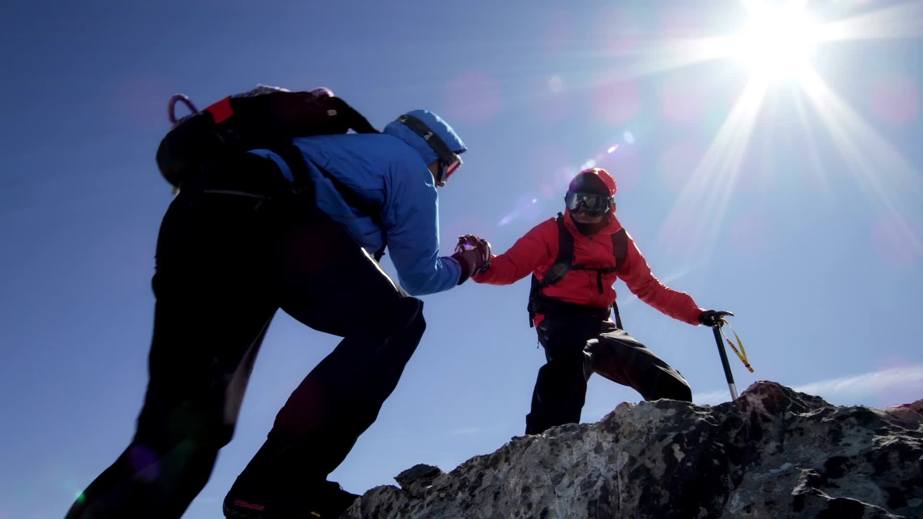
Extreme basics of cinematography

Slide 6
Important basics of cinematography not covered today
DSLR Basics
White balance
Gimballs

Slide 7
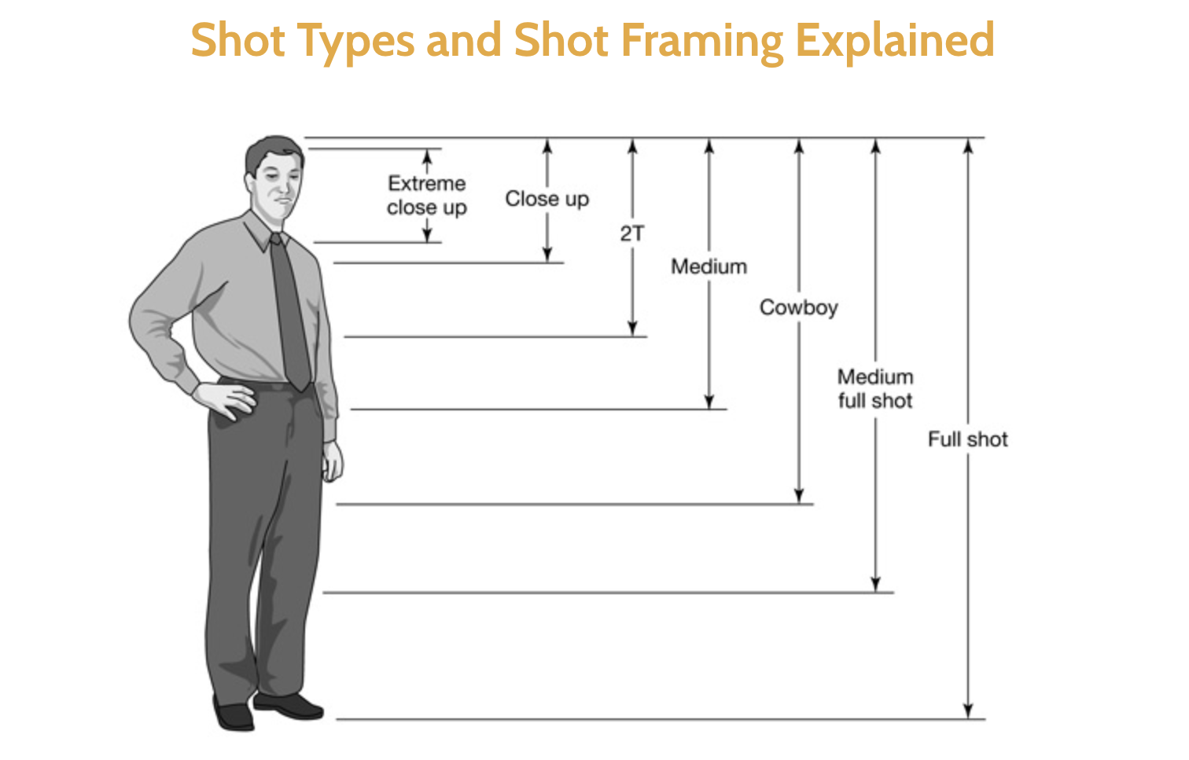
Proper framing

Slide 8
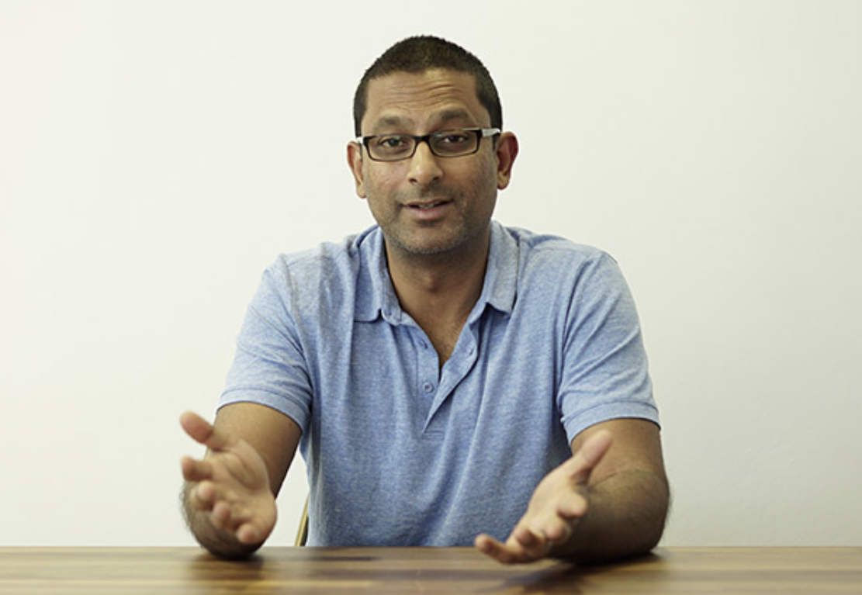
Proper framing for an interview

Slide 9
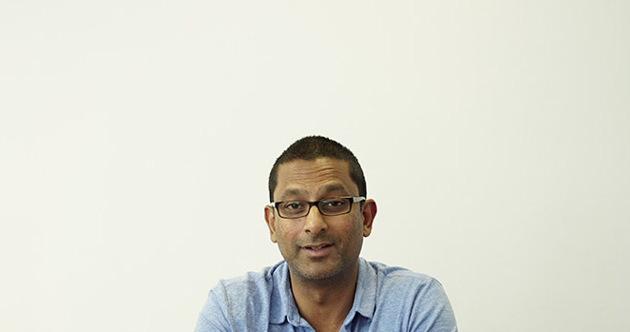

Improper framing for an interview

Slide 10
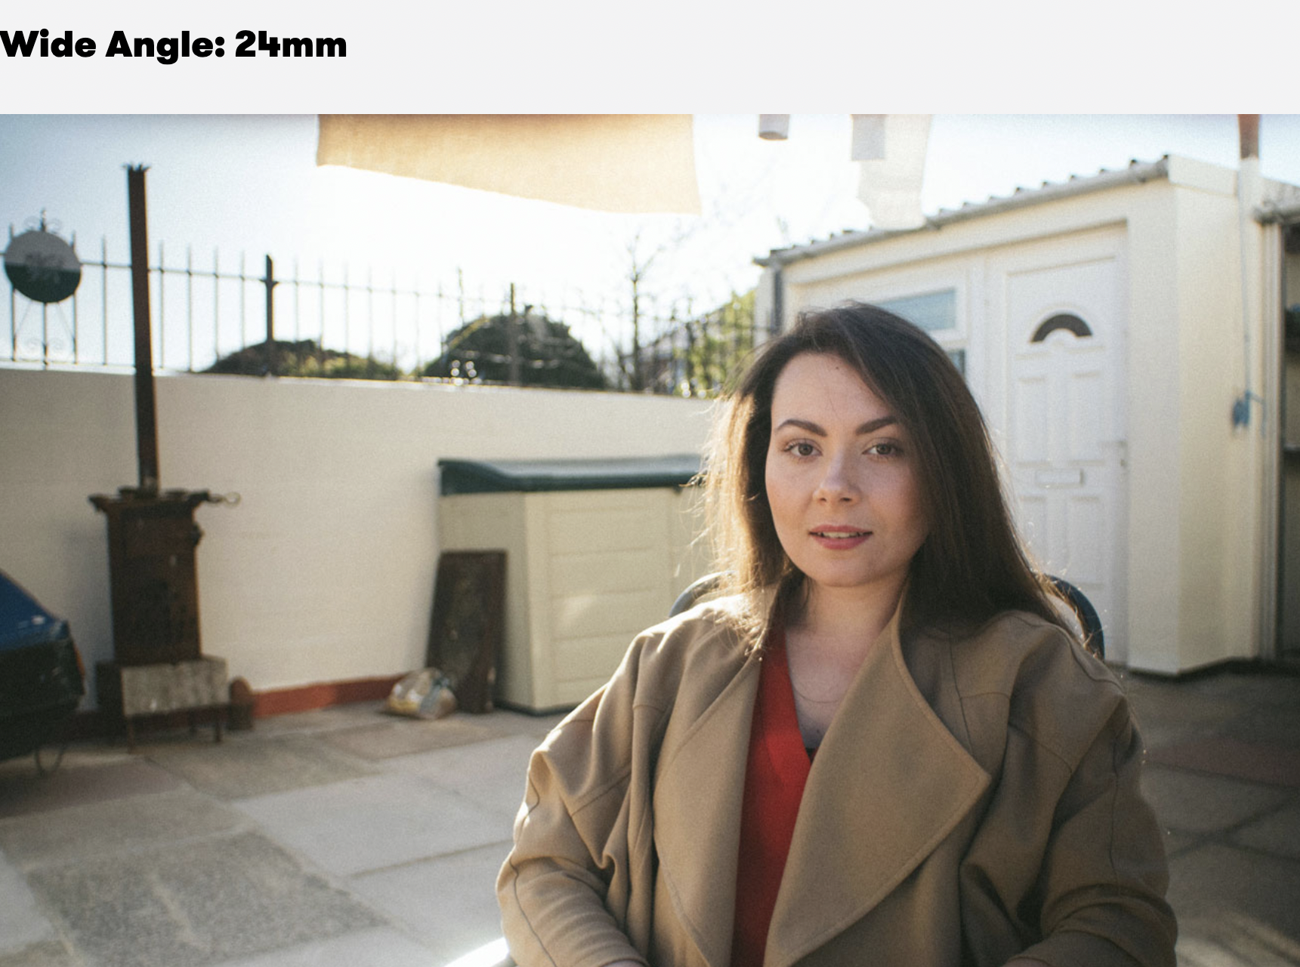
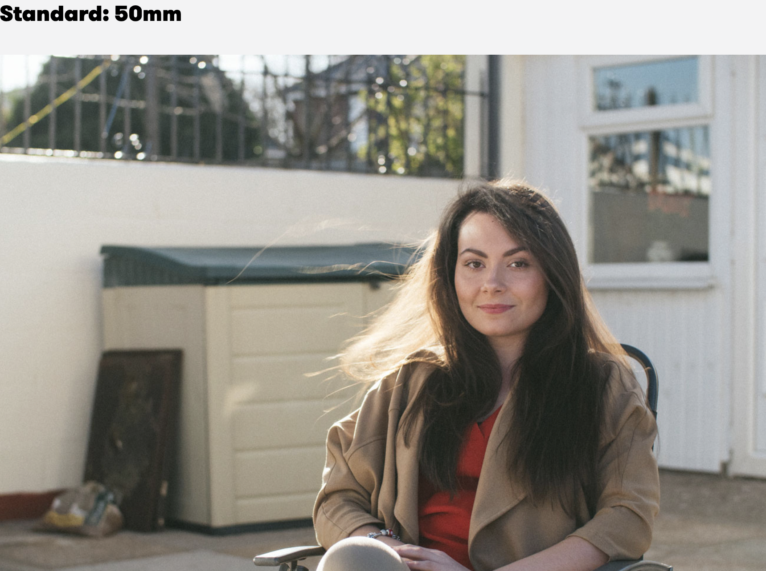
Wide Angle vs. Telephoto
A wide angle lens keep most everything in relative focus.

Slide 11
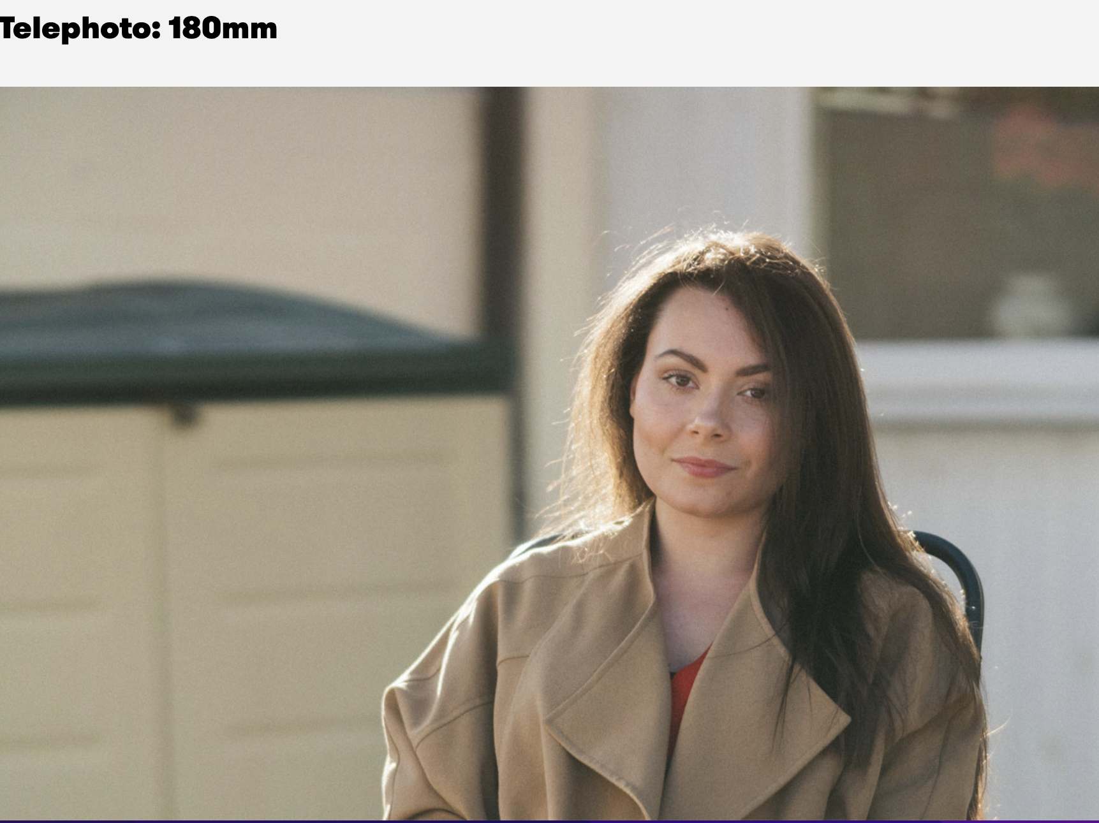
Wide Angle vs. Telephoto Lens
A telephoto lens truly
accentuates
the subject.

Slide 12

Lighting
Your best
source
of light

Slide 13
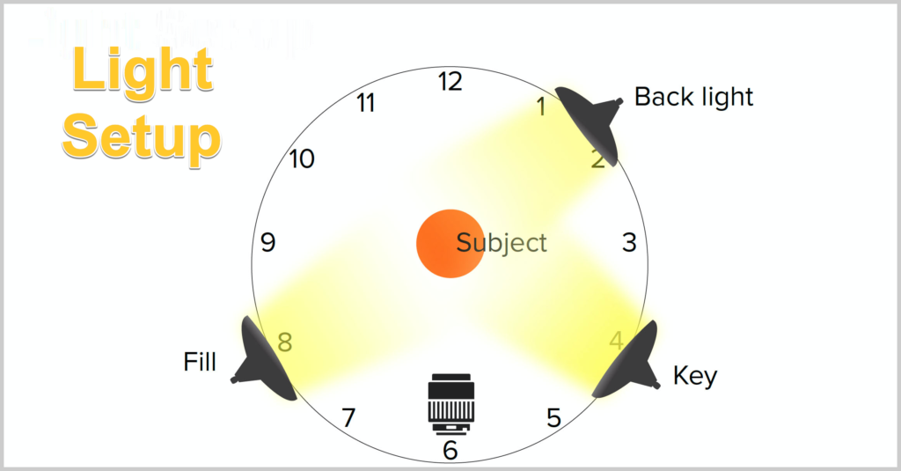
Lighting cont’d
Ideal lighting

Slide 14

Lighting cont’d
Not ideal lighting unless
a beautiful silhouette is what you’re
going for. Avoid shooting into the sun.

Slide 15
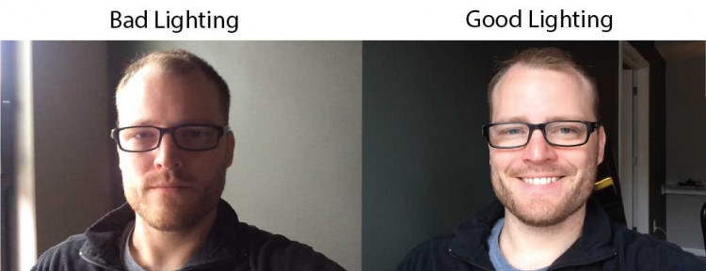
Lighting cont’d

Slide 16
Send us your footage:
Canto link:
There’s no guarantee we’re going to use this footage but
It’s always good to have things stored in a large repository in
case we need it.

Slide 17
Some last things to remember:
Do the best with what you have.
The more you shoot, the better you’ll get.
Marcom can always try and fix it in post.
We can straighten out an image, fix exposure, saturate, modulate sound levels, etc. etc.
So give us a try!

Slide 18
Contact me with any questions:
pmatsoukas@marian.edu
Thank you for your time!

