Slide 1
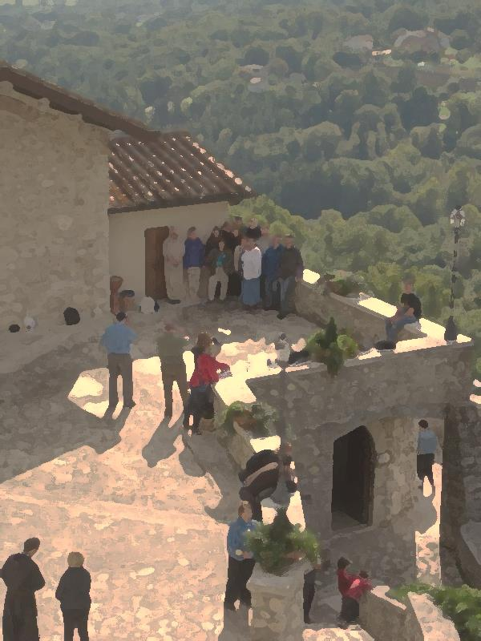
AFCU Symposium 2016: Preparing Outstanding Leaders for the Modern World
Franciscan Career Transformation: Bridge to the World
Brother Gregory Cellini, O.S.F.
Mary Beth Wisniewski M.S., L.P.C.
Notes:
[greg]
Great afternoon everyone. mary beth and I welcome you to our discussion regarding Franciscan Career Transformation: Bridge to the World. We use the term “discussion” because we desire for this session to be very interactive.
The first way we wish to interact is in prayer. In the name of the Father, and the Son and the Holy Spirit:
Given the exciting nature of today, let us take a few moments to be in silence to remind ourselves we are always in the presence of our awesome Creator. [Pause] Great and Gracious God, once again we do not have to look far for the incredible gifts you have provided today. This beautiful day. This wonderful Symposium. Another opportunity to share Your good. Bless our conversation this afternoon so that we can truly do Your will and help prepare outstanding leaders to transform into whom You want them to become. Amen.
The next way we wish to interact is by getting to know each other. Let’s please go around the room and have each person introduce yourself by sharing your name, institution, role and the first job ever had.
[mary beth and greg go last]

Slide 2
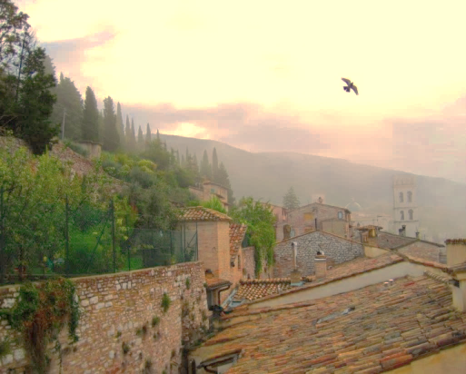
We Are Here Today…
To share information regarding Franciscan Career Transformation: Bridge to the World (FCT)
GOAL: To encourage you to consider offering this program at your institution.
Enlighten and Inspire!
Notes:
[greg]
Why have we gathered today? The main reason is to share information regarding Franciscan Career Transformation which will motivate you to consider offering the program at your institution. We hope before the end of this session you will start to reflect on ways to further incorporate the Franciscan tradition into your Career related activities.
Today, we aim to enlighten you but, even more so, inspire you to consider taking action. Please feel free throughout the session to share any questions or comments you may have.

Slide 3
Information Sharing Includes FCT’s…
History
Overview
Objectives
Benefits to Institution
Tangible Output
Content
Offering Options
Notes:
[greg]
mary beth and I have compiled much information regarding Franciscan Career Transformation. Today we wish to provide a portion of that Good, important aspects such as history, objectives and especially offering options. We have found there are many ways to integrate this program into a Franciscan institution.

Slide 4
Let’s Continue by Sharing the Good with Each Other!
Please break up into groups of three and answer either of the following questions assigned:
1. What one insight about yourself has been especially beneficial to know in your career?
2. What Franciscan Values have been particularly present throughout your work life?
Notes:
[mary beth]
As was said before, we want this session to be very interactive. Therefore, let’s continue sharing the Good by breaking up into groups of three and discussing the questions on the slide. Let’s please have the groups on the left side of the room discuss question one and the right side of the room discuss question two.
[mary beth leads immediate debrief]
[greg]
It is very evident just how important self awareness and Franciscan Values have been to your career. Just imagine having had these insights about yourself and Franciscan Values when you started your career. I suspect your work lives would have been even more fulfilling, and your contribution and ability to lead even greater. Obtaining insights such as these early in one’s work life is what Franciscan Career Transformation is all about.

Slide 5
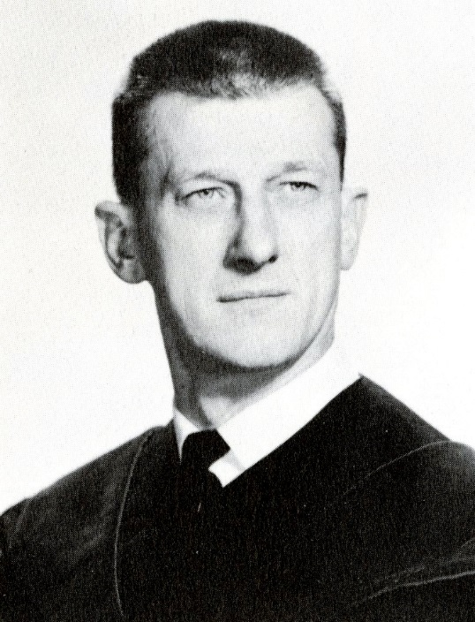
FCT Was Born in 1984!
Notes:
[greg]
Now we are going to delve into some of the aspects of FCT. The first is its history.
It was Stanley P. Kosakowksi - my beloved advisor at Seton Hall University pictured here – who planted the seed for FCT. During the fall of 1984, I took Stan’s Business Policy class. In those days, while most Business Policy professors were giving there students Harvard Business Review case studies to read, Stan had his students form simulated companies and take Leadership positions in the firm. Stan believed it was not by reading about Leadership - but by experiencing it – that each student would learn more about herself or himself.
Professor continuously asked the question, Quo Vadis: Where the Goest Thou? Stan thought it was possible for someone to become an outstanding leader only if he or she knew where they were now, where they were going and how are they going to get there. Stan’s class was the greatest academic learning experience I ever had. It was upon conclusion I vowed that, if I ever got the opportunity, I would assist compile a program helping future leaders answer these critical questions about themselves.

Slide 6
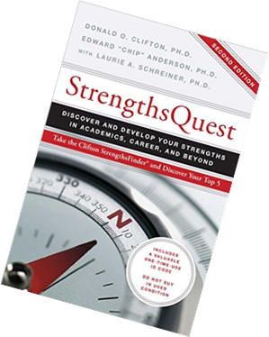
FCT Found Strength in 2005!
Positivity
Developer
Empathy
Woo
Relator
Next 28 Strengths
Competition
Connectedness
Intellection
Individuation
Learner
Relator
“Your profile is much more geared to Religious Life than Corporate Life. What are you doing there?”
Rosemary Travis, Gallup Coach
Notes:
[greg]
The importance of self-awareness become especially evident during 2005. The Big Pharma company with whom I was working for at the time – I had been there for 29 years - kindly provided me career coaching from the Gallup Organization. In preparation for the initial session, I completed the StrengthsFinder assessment. This slide shows my top five strengths, along with my weakest strength being Competition.
I will never forget the words of Rosemary Travis, my Gallup Coach, which appear on the bottom of the slide. It was this assessment and Rosemary’s coaching which inspired the decision to become a Franciscan Brother of Brooklyn - to transform from where I was - wandering down a pointless road to nowhere - to journeying the true path God had planned for me. I am eternally grateful to Rosemary and am honored she has graciously joined us today.
mary beth’s strengths are also listed here. Their relevance to FCT’s history will become apparent on the next slide.

Slide 7
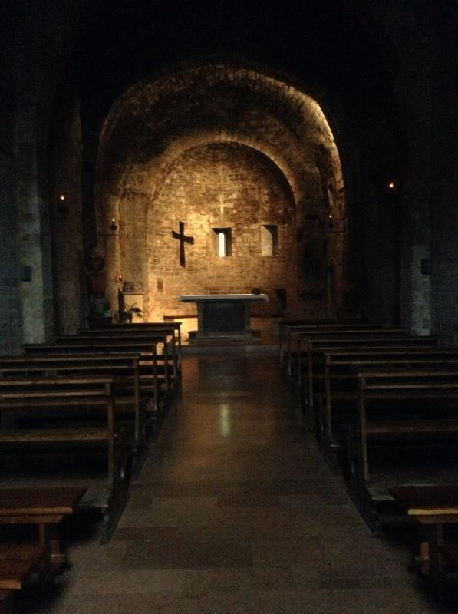
FCT’s Transformation Moment Occurred in October 2013!
Notes:
[greg]
FCT’s transformation moment – its embracing the leper moment - occurred in October 2013. It was on pilgrimage in Italy that I met mary beth and we went to tiny Santo Stefano church in Assisi. Our plan was to stay an hour and then explore the Piazza Del Commune; however, God had other plans. A driving rainstorm lasted for over 90 minutes, resulting in us staying in church. During the extra time, my heart started wandering. My dream of developing a program for future leaders surfaced, but I quickly dismissed it because of not having the strengths needed.
When mary beth and I finally got to the Piazza and sat down over a cup of cappuccino, she shared with me her background was in counseling and career coaching. At that moment, I realized mary beth had the strengths I was lacking. The Holy Spirit motivated me to ask whether she would like to co-develop a program for college students on Franciscan conversion, to which mary beth immediately said yes. Development on FCT began, which has lead us to be here today.
Now that you know it’s history, mary beth and I will now delve into some additional important aspects of the program.

Slide 8
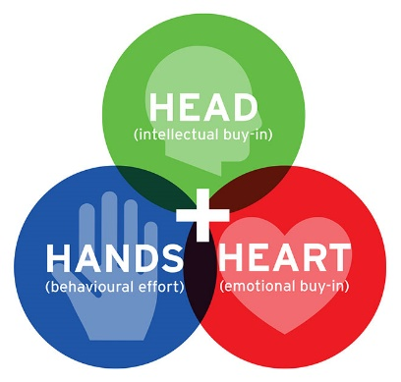
What is FCT?
FCT is a program offering students/alumni a Franciscan, holistic approach to owning one’s career.
Participants will have the opportunity to experience a transformative process by which they become inspired to enhance self-awareness, realize their unique potential, discover their professional passion, ground decision making in their spiritual and moral values, and maximize their contribution to the world.
They will learn how to effectively guide their career and to create a career development portfolio to use as a tool when pursuing desired professional opportunities.
Transformational Change:
Involves Breakthroughs
Engages the Heart
Is about Being the Change
Notes:
[mary beth]
What makes FCT different than many career and life choices courses is its transformational nature.
And to understand this, we need to know: What is transformational change? What does it look like? How do we encourage it?
When we look to Francis’ and Clare’s transformational moments, we see they arise in encounter. They seem to come after times of reflection, solitude, and are completed, fulfilled in and by action. It was through action that Francis learned the difference between talking about loving a leper and embracing one.
Robert Gass who is co-founder of the Rockwood Leadership Institute says:
Involves breakthroughs- shifts in paradigms, beliefs and behaviors
Engages the heart- While acknowledging importance of intellect, TC equally engages the heart, embracing our deepest aspirations
Is about Being the change It will impact heart, mind and society as we begin to be the change we want to see in the world.
Transformational change is “profound, fundamental and irreversible.
For transformation to occur we will need to have not only an intellectual understanding but lived experience. We will encounter, and integrate, new understanding.
In FCT we use Francis as our guide: and we incorporate tools to increase the likelihood students will take time for silence and reflection and step into action and encounter.

Slide 9
What Are FCT’s Objectives?
Encourage contemplation and in-depth reflection so as to gain awareness of gifts, values, patterns, and choices; to encounter one’s self deeply, and arrive at new understanding.
Increase self-awareness of personality style, strengths, and interests.
Create key life elements including Values Set, Mission Statement, Vision Statement and Goals List
Identify core Franciscan Values e.g., respect, gratitude, and be challenged to integrate these into their professional and personal life
Understand and apply various components of the Career Leadership Life Cycle, including determining aspirations, preparing documents of introduction, and interviewing
Develop and present a Rule of Work Life portfolio
Notes:
[greg]
This mission statement – if you will - of FCT just spoken about can be broken down into these six objectives. You can read them as easily as I can say them and we will say more about these in a few minutes.
These objectives very much tell the story of FCT. It is about looking deep inside oneself to identify key life elements. It is about seeing the role Franciscan Values can play in one’s life. It is about using what has been learned to lead one’s career and develop a Rule of Work Life to confidently share with potential employers.
Let’s briefly touch upon the importance of one key life element – a personal mission statement – in preparing outstanding leaders. According to an article in the May 2014 issue of the Harvard Business Review entitled From Purpose to Impact, fewer than 20% of leaders can distill their own individual life purpose into a concrete statement. The article authors go on to say that, “The process of articulating your purpose and finding the courage to live it is the single most important development task you can undertake as a leader.” Compiling a concrete mission statement, therefore, provides the FCT participant significant competitive advantage over the so many other people who do not do such.

Slide 10
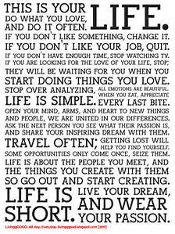
Rule of Work Life Is the Tangible Output!
Values, Mission, Vision and Goals
Results of Assessments
Resume
Other
Notes:
[greg]
As a member of the Franciscan Brothers of Brooklyn, I have vowed to live by the Rule and Life of the Brothers and Sisters of the Third Order Regular of St. Francis. Every decision I make is ideally guided by this Rule and Life.
The Rule of Work Life is the guiding document for the student/recent alumni. It is a portfolio crafted by the participant containing information such as values, mission and vision statements, goals and results of assessments. All of these are meant to be guideposts for maximizing contribution to the world and introducing their authentic self to potential employers. mary beth will shortly talk a bit more about the Rule of Work Life, one unique feature of FCT.

Slide 11
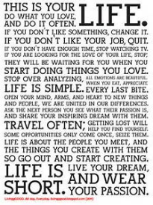
To Achieve Its Objectives, FCT Contains Six Segments
Reflection Tools and Transformation Stories: Franciscan tools helpful for self-awareness, e.g., contemplation, journaling, and the conversion story of St. Francis of Assisi.
Self-Assessments: Targeted assessments for enhancing self-awareness, e.g., Myers-Briggs Type Indicator, Strong Interest Inventory.
Core Life Elements: Values, Mission, Vision, and Goals.
Franciscan Values: Ideals of St. Francis, St. Clare and other Franciscans whose lives model values essential for the workplace.
Career Leadership Life Cycle: Strategies/Tactics integrating all of the above for understanding and applying the components of the Career Leadership Life Cycle.
Rule of Work Life: Covenant summarizing the path forward.
Notes:
[mary beth]
You will note that across our discussion today, you have heard much about the need for reflection, and action. Bullets 1-4 highlight the reflection tools and topics
In addition, it is the intention of the program to include career-specific elements like documents of introduction and interviewing.
The program culminates in a presentation of each participant’s Rule of Work Life: This can be as structured or creative as a student desires. It may be:
A narrative/story for reflection-
A synopsis
A mission statement or dreamboard or a webpage
It can be used in several ways: It will be a very useful tool for reflection:
As I look at my Rule of Work life, what do I notice as strengths and skills and aspirations? Which of these do I want to share with an employer?
Does the job I am seeking suit my needs and align with my values?
As I look at my Rule of Work Life, Has my vision changed? Have my goals changed?
Some students may wish to use it as a presentational portfolio of work or the beginnings of a blog or other creative endeavor.
However they create it, through the Rule of Work Life a student learns to tell their story and offer their gifts to the world.

Slide 12
To Achieve Its Objectives, FCT Contains the Following Components:
Self-Awareness
Where Good
Meets
Career!
Franciscan Values
Career Leadership
Life Cycle
Notes:
[greg] Another of the unique features of FCT is the blend of self-awareness, Franciscan Values and career leadership. Many programs contain elements of self-awareness and career leadership, but not Franciscan Values. As you demonstrated earlier, there is a strong linkage between Franciscan Values and career.
According to renowned author Fr. Andre Cirino, O.F. M., one of the most important Franciscan Values is sharing the Good. In fact, according to Fr. Andre, "The greatest violation of the commitment to Franciscan Poverty is to hold on to the Good".
FCT helps the participant become self-aware of their Good. For our students, this is very important. I can only speak for New York City – attending school in the concrete jungle is filled with turbulence, frustration and challenges. Sadly, many college students – regardless of where they are located – have difficulty seeing the Good they possess.
One cannot be what they cannot see. Therefore, a key role as educators is to help each student see the Good inside themself and inspire her/him to share this Good to maximize their contribution to a broken world. Going from not seeing their Good to sharing their Good - this is transformation at its finest!
Think about the transformation contained in Man of La Mancha. It only was when Don Quiote helped others see their Good that they transformed. I believe a key line in the story is when Aldonza says, “Why does he see all the Good he can see, and what does he want of me?” The essence of FCT is the facilitator helping participants see their Good, with each individual reflecting for themself on their Good and, through this process, moving toward their quest.

Slide 13
FCT Can Be Offered Via Various Methodologies!
Single/Multi Semester Course(s)
Intercession Certificate Program
Workshops
Peer-Group Learning Set
FCT Can be a Bridge to the World for Current Students or Recent Alumni!
Notes:
.
[greg]
One of the many nice features of FCT is its versatility. The WhatCanBe for this program is only limited by as far as one can see.
FCT can be offered in a variety of formats, including:
Single/Multi semester course(s) for credit
Certificate program offered between the Fall and Spring semesters
Series of workshops during a semester
Peer-Group Learning Set, in which participants learn much not only from a Facilitator, but each other
Alternative methodologies have been established in an attempt to meet the needs of various situations. For example, the workshop format is better for an institution where a majority of the students live there, while the intercession certificate program is more geared for a commuter school such as St. Francis.
The program is not only for current students, but is well-suited for recent alumni as well. Recent alumni – being in a liminal state - can especially relate to the experience being a bridge to the world.
Much information has been compiled regarding these alternative methodologies. As one example, we have prepared a complete syllabi for a single semester course offered multiple times per week.

Slide 14
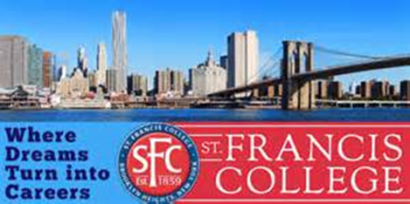
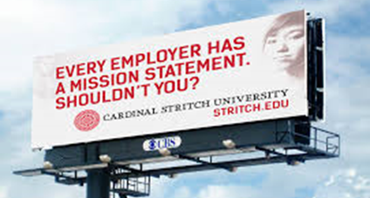
FCT Also Benefits Institutions
A key measurement of higher education performance is the percentage of graduating students finding meaningful work after graduation
Program is designed to enhance this percentage, as students will better know themselves, be able to advocate for themselves and have the core competencies crucial for obtaining employment
FCT may help with retention and persistence of students
“Courses and programs that build mentoring and support groups into their designs help improve levels of student involvement, motivation, and academic self-confidence and, in turn, increase levels of institutional commitment and engagement .” (Padgett and Reid 2003)
FCT aligns well with the Mission of integrating Franciscan Values into the institution
Notes:
So far we have touched upon the benefits for the FCT participants. Certainly, Finding meaningful work is a great benefit for each student. Finding meaning in one's work has been shown to increase motivation, empowerment, job satisfaction, and performance and to decrease absenteeism and stress. But the benefits extend beyond the student.
Helping students find meaningful work is also a draw for future students. If you are a parent, and you saw a college with a poor track record in helping students find meaningful work, would you send your child there? As much as we value a Liberal Arts Education for its own sake, measurement is something we live with, and students and their parents are reading the numbers.
One of the numbers FCT could also help with is retention. The group discussions and mentoring that accompany the FCT process align with what research indicates will help in retention of students.
Primarily, and most of all, FCT aligns with each of our missions, and our dedication to integrating Franciscan values into all we do so that we continue to live the Franciscan tradition and bring forth our next generation of leaders.
______________
In our bibliography we have several links to studies which support how FCT can benefit institutions.
[mary beth]

Slide 15
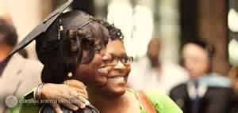
FCT Was Introduced at St. Francis College in February 2016
Peer-Group Learning Set
January 2016 Graduates
Seven Sessions
Rule of Work Life Presentation
“FCT is exactly what I needed!”
“I am beginning to see the path down which I should travel.”
Notes:
[greg]
The initial offering of Franciscan Career Transformation at St. Francis College commenced in February with recent alumni. Several January 2016 graduates had expressed a desire for more assistance from The Career Center. A Peer Group Learning Set was formed consisting of a handful of interested alumni.
The program has continued into June and will contain seven sessions. It is proving to be quite a transformative experience for the participants, as you can see from the two quotes.
Any questions or comments at this time?

Slide 16
Let’s Debrief
Please again break up into your groups to answer the following:
1. Based on today’s discussion, are there any applications of FCT at your institution which come to mind?
2. What insights, ideas, comments, concerns, program gaps, etc., regarding FCT would be helpful to raise?
Notes:
[mary beth]
Let’s please break back into our groups of three to discuss the two questions on the slide.
[mary beth leads debrief]

Slide 17
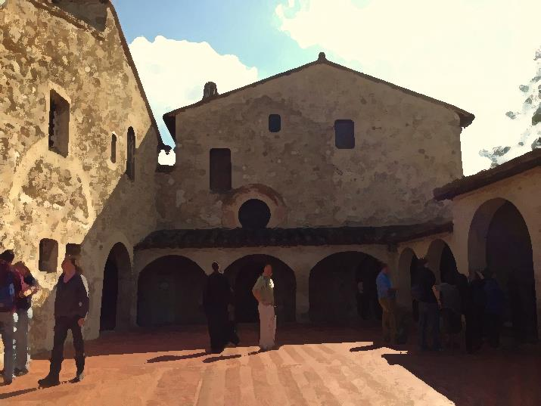
For More Information Regarding Franciscan Career Transformation
Brother Gregory Cellini, OSF (greg)
Franciscan Advisor -
St. Francis College
gcellini@sfc.edu
(718) 489-5260
Mary Beth Wisniewski, MS, LPC
Wellness Counselor -
Cardinal Stritch University
AFCU Contact -
Franciscan Pilgrimage Programs
mbwisniewski@stritch.edu
(414) 410-4146
Notes:
[greg]
You can sense that mary beth and I strongly believe in the impact Franciscan Career Transformation can have on preparing outstanding leaders for the modern world. Please contact us for more information, as we will be only too happy to share the rest of the Good with any of you who wish to learn more and leverage what we have done.
When we started this session, it was stated the main purpose was to share information regarding FCT which would motivate you to consider offering the program at your institution. From what we heard, it sounds like many of you have been inspired to consider taking action when you return to your schools to further incorporate the Franciscan tradition into your Career related activities.
Are there any final questions or comments?
We thank you very much for attending today’s session and look forward to journeying with you on Franciscan Career Transformation and the rest of the Symposium. As we move forward, it is only fitting to close with a prayer from St. Clare:
[mary beth]
“In the name of the Father and of the Son and of the Holy Spirit. Let us pray.
What you hold, may you always hold; what you do, may you always do and never abandon. But with swift pace, light step, unswerving feet, so that even your steps stir up no dust, may you go forward securely, joyfully, and swiftly, on the path of prudent happiness. Amen.”

Slide 18
Bibliography/Resources
Gass, Robert. 2010. What is Transformational Change. Retrieved from http://transform.transformativechange.org/2010/06/robertgass/
Grant-Vallone, E., Reid, K., Umali, C., & Pohlert, E. (203-2004). An Analysis of the Effects of Self-Esteem, Social Support, and Participation in Student Support Services on Students' Adjustment and Commitment to College. Journal of College Student Retention: Research, Theory & Practice, 5, 255-274. Retrieved from http://eric.ed.gov/?id=EJ773523
Lotkowski, V. A., Robbins, S. B., & Noeth, R. J. (2004). The role of academic and non-academic factors in improving college retention: ACT policy report. PsycEXTRA Dataset. Retrieved from http://files.eric.ed.gov/fulltext/ED485476.pdf
Weir, K. (2013). More than job satisfaction: Psychologists are discovering what makes work meaningful--and how to create value in any job. PsycEXTRA Dataset; American Psychological Association, 44(11). Retrieved April 7, 2016, from http://www.apa.org/monitor/2013/12/job-satisfaction.aspx
Macchia, Stephen. Crafting a Rule of Life. https://ruleoflife.com/the-invitation/

